Slide 1
Topics discussed
Introduction to Deep learning.
MNIST classification.
Convolution operation and CNN.
Loss functions and Hyper-parameters.
Fashion MNIST classification ( Overfitting and regularization (Dropout) ).
Different CNN architectures (VGG, ResNet, Inception, etc)
Transfer learning and multi-class classification.
Auto-encoders.
Optimization algorithm and their usage.

Slide 2
Object localization and Detection

Slide 3
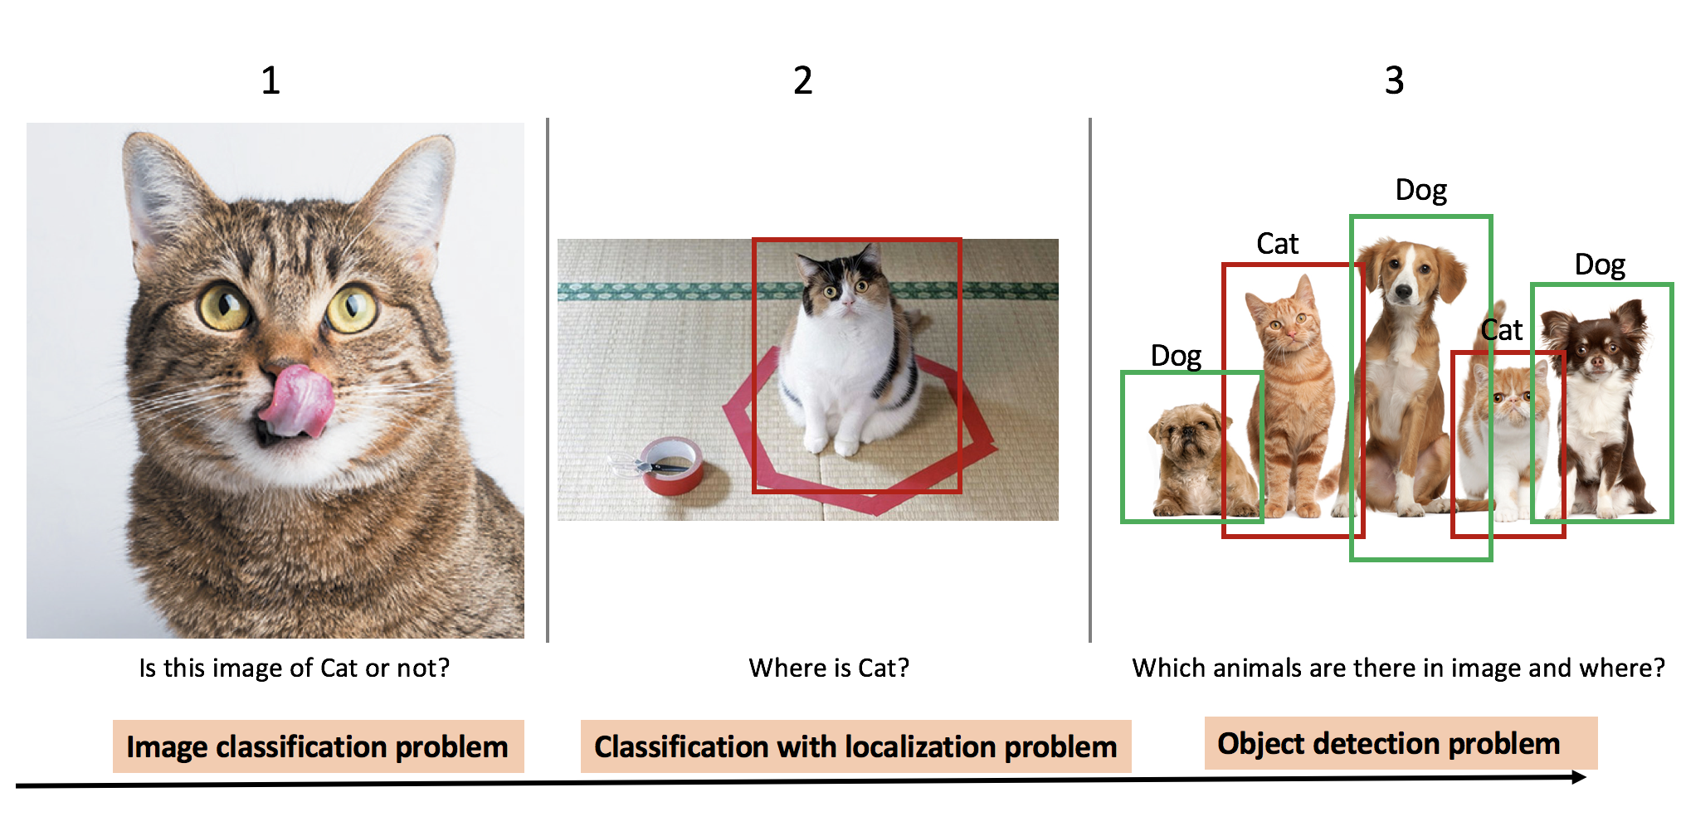

Slide 4
Object Localization
The term localization refers to figuring out the location of a specific object in an image.
We usually localize objects in images by determining their bounding box.
Bounding boxes are the rectangular boxes that are specified by the x- and y-coordinates.

Slide 5
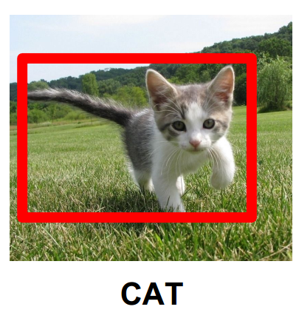

Slide 6
Bounding box representation
Centroid representation - A bounding box could be represented as [x,y,w,h], where x and y are the coordinates of the bounding box centroid, w and h are the width and height of the bounding box.
Corners representation - A bounding box could also be represented as [Xmin, Ymin, Xmax, Ymax], where Xmin and Ymin are the coordinates of the bounding box bottom-left corner, Xmax and Ymax are the coordinates of the bounding box top-right corner.

Slide 7
MinMax representation - Similar to the corner representation, a bounding box could also be represented as [Xmin, Xmax, Ymin, Ymax] where Xmin and Xmax are the minimum and maximum of the x coordinates, Ymin and Ymax are the minimum and maximum of the y coordinates. It is almost identical to the corner representation.
3.

Slide 8
Classification with Localization
For classification problems, we had a Softmax layer at the end which gives the probability for each of the classes.
To localize the object in an image, we can modify our network to output few more values that give us the bounding box co-ordinates.
The training set must contain the bounding box co-ordinates along with the label.

Slide 9
This gives us a supervised learning problem. In other words, we can make the model learn not just the labels but also the bounding box co-ordinates.
The output should contain the output of Softmax layer and also the bounding box values predicted by the model.

Slide 10
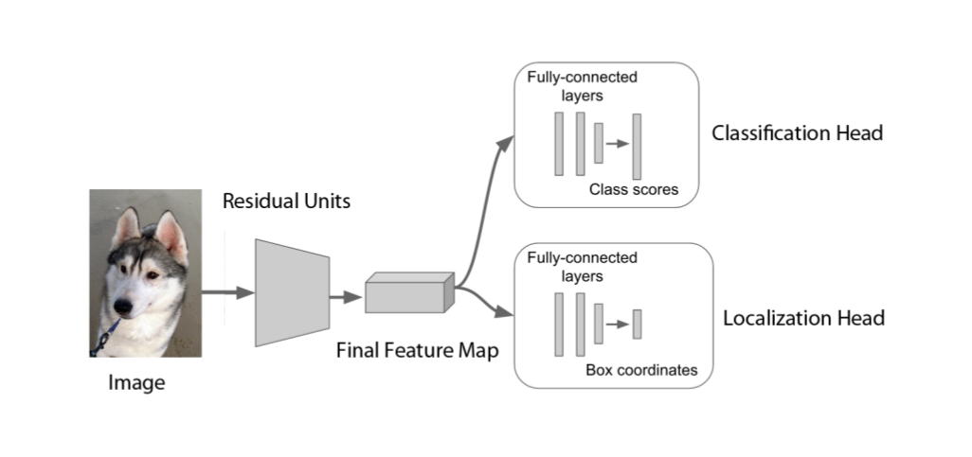
Training

Slide 11
Landmark detection
In landmark detection or key point detection, we are just making our network output the important x and y co-ordinates in an image.
For example, if we want to detect specific set of points on images of faces, the training set should contain those points along with the images.

Slide 12
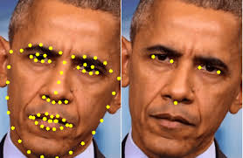
The image on the left contains 65 key points detected and the image on the right has 5 key points detected.

Slide 13
The training set should contain these 130 points (65 * 2) in a specific order for all the images.
If some points are not available for some images, that points should be marked as NA in the training set.

Slide 14
Application of Landmarks detection
Facial expression recognition.
Pose estimation.
Drowsiness detection.
Hand gesture recognition and more.

Slide 15
Sliding Window detection algorithm
The idea behind this algorithm is to pass a specific region of the input image through the classifier(CNN) and repeat this process for the entire image by passing all the regions.
The region size is determined by the window size. This window is slided across the image to select different regions.
By using this algorithm, we are passing multiple cropped regions of the images through the classifier and classifying each region.

Slide 17
Advantage:
We are able to detect multiple objects in an image.
Disadvantage:
We normally run this algorithm multiple times for different window sizes. The computation cost is very high which makes this algorithm slow.
If we use a larger stride value for the sliding process, we can reduce the computation cost but the performance reduces.
We can overcome this by the Convolutional implementation of sliding window algorithm.

Slide 18
Convolutional layers and FC layers
Neurons in a FC layer have full connections to all the activations in the previous layer.
The only difference between a FC and Conv layers is that the neurons in the Conv layer are connected to a local region in the input. Also, many of the neurons in a Conv volume share parameters.
However, the neurons in both the layers are still computing the dot products, so their functional form is identical.

